Slide 1





12 BIT SYNCHRONOUS COUNTER
EEE 468 – VLSI Laboratory
Jan 2024 Level -4 Term -2
Final Project Demonstration
Submitted by – Group 04
Rokon Uddin Mahmud
1906140
Rabeya Salam Munira
1906141
Aliva Sadnim Mahmud
1906146
Abrar Faiaz Eram
1906167

Slide 2
Outline
Abstract
Introduction
RTL code
Directed Testbench code
Layered Verification
Synthesis Optimization
PnR Optimization

Slide 3
Abstract
This project presents a 12-bit synchronous counter designed to perform up/down counting operations based on a control signal.
The counter incorporates several control inputs: Load, Up/Down, Reset, and Enable. When the Load signal is high, the counter will be loaded with a 12-bit value from the input bus A[11:0]. The Up/Down signal determines the direction of the count: up for high, down for low. The Reset signal forces the counter to zero. The Enable signal controls the overall operation of the counter, allowing it to be paused when low.
The counter is driven by a clock signal and operates synchronously with the positive edge of the clock.

Slide 4
Introduction
A 12-bit synchronous counter is a digital circuit capable of counting up or down in binary code, synchronized to a common clock signal. This project focuses on designing and implementing such a counter with several control inputs to enhance its functionality.
By incorporating control signals like Load, Up/Down, Reset, and Enable, the counter can be configured to perform various counting operations. This flexibility makes it suitable for a wide range of applications, including timing circuits, frequency dividers, and digital signal processing systems.

Slide 5
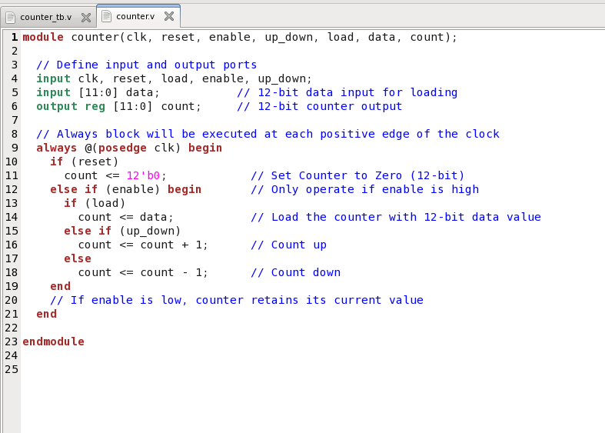
RTL design code:

Slide 6
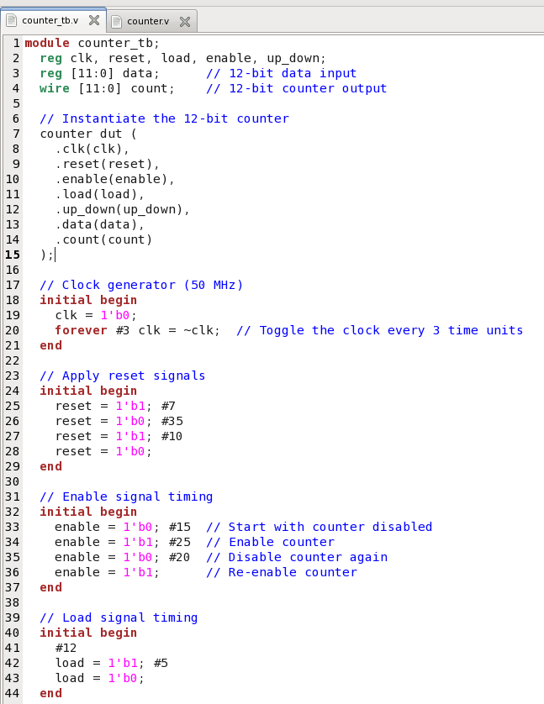
Directed Testbench code:

Slide 7
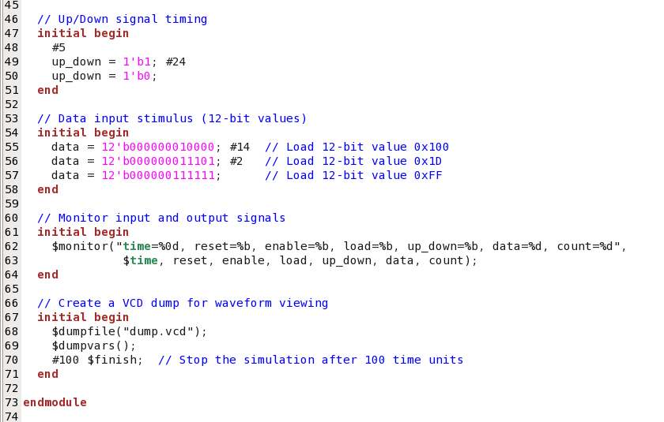
Directed Testbench code:

Slide 8
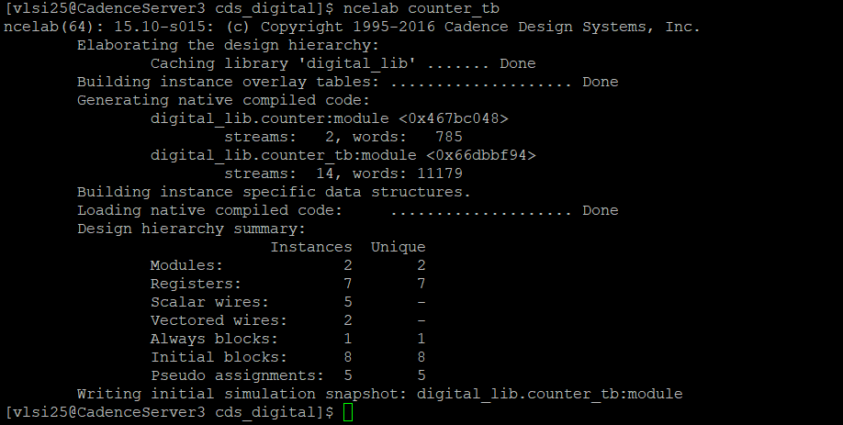
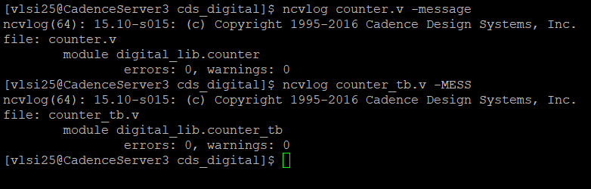
Directed Testbench analysis:
Output

Slide 9
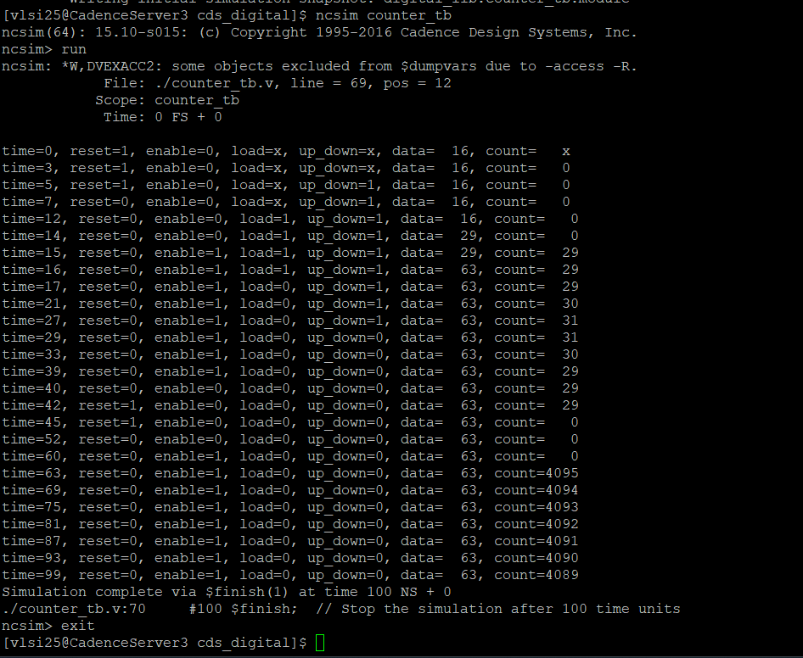
Directed Testbench analysis:
Output

Slide 10
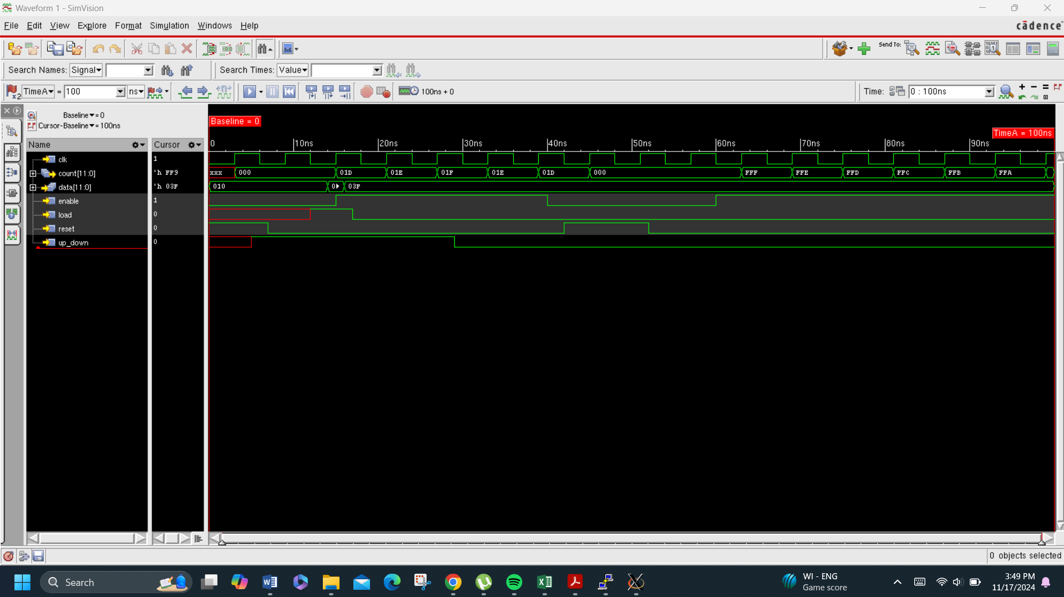
Directed Testbench analysis:
Waveform

Slide 11
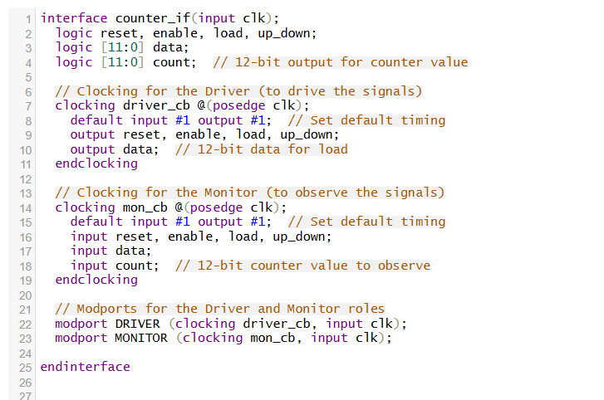
Layered Verification:
Code
Interface

Slide 12
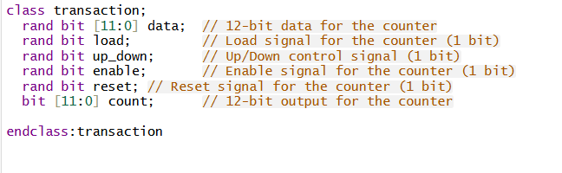
Layered Verification:
Code
Transaction

Slide 13
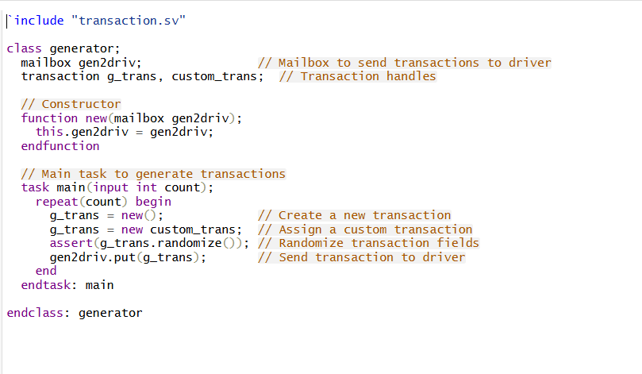
Layered Verification:
Code
Generator

Slide 14
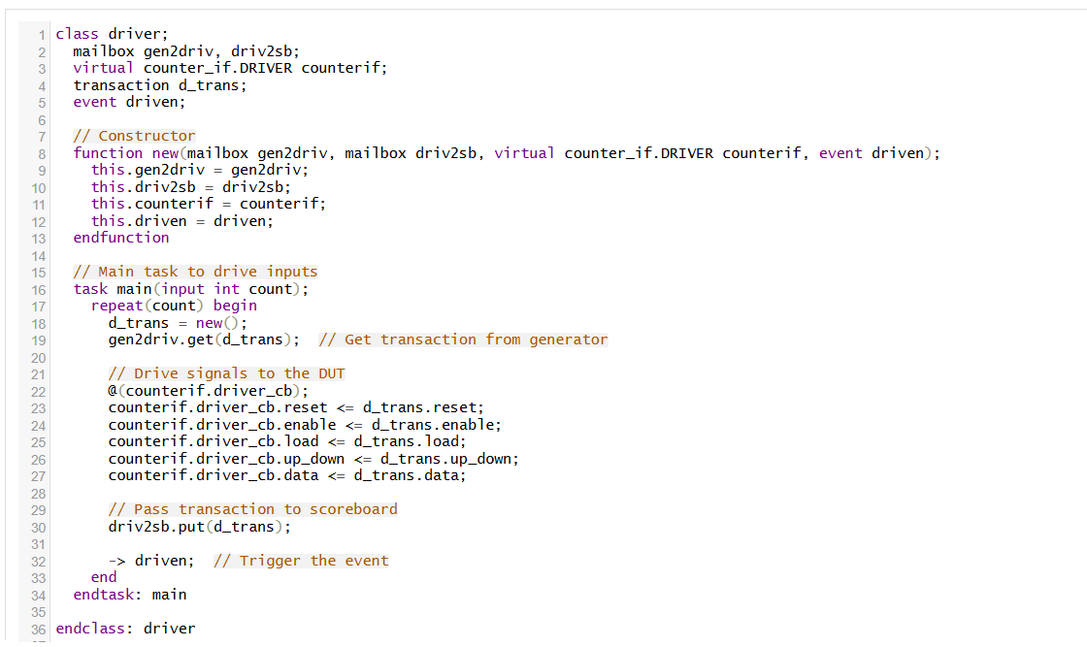
Layered Verification:
Code
Driver

Slide 15
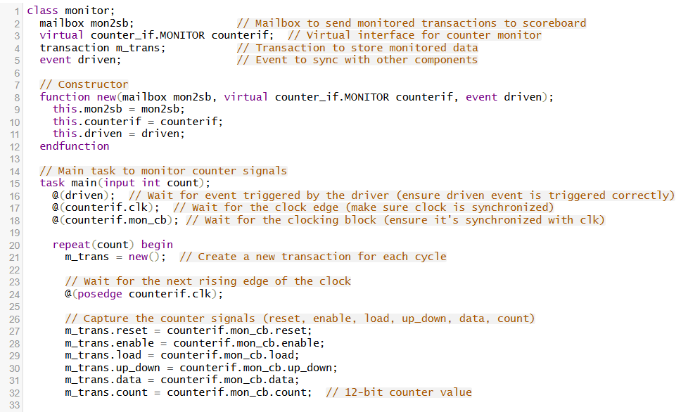
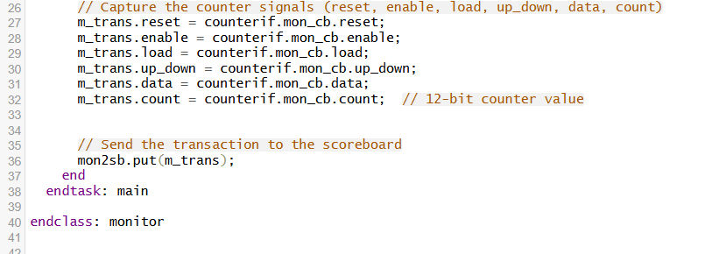
Layered Verification:
Code
Monitor

Slide 16
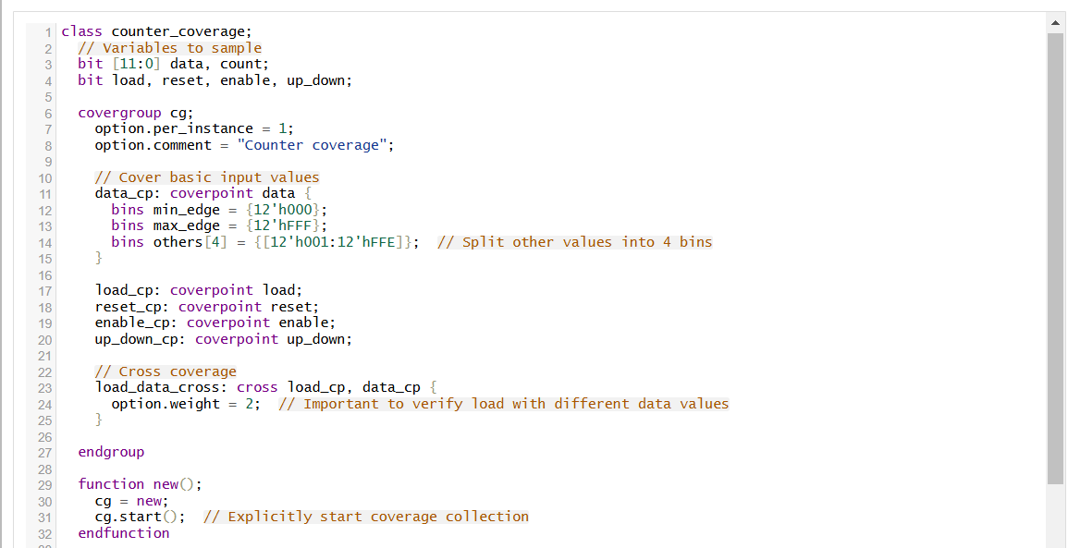
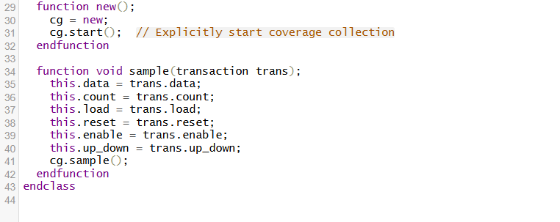
Layered Verification:
Code
Coverage

Slide 17
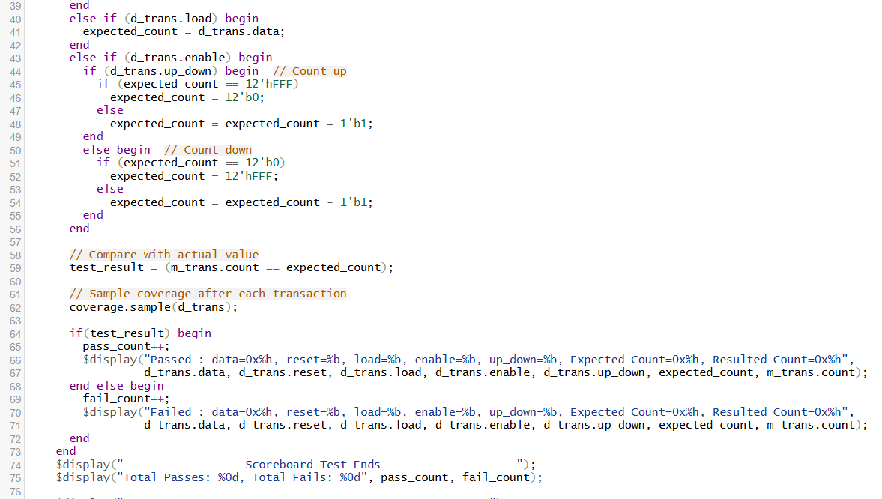
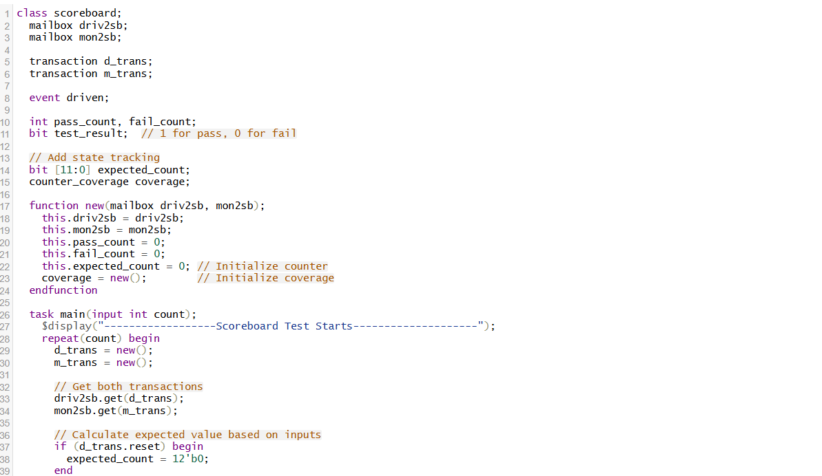
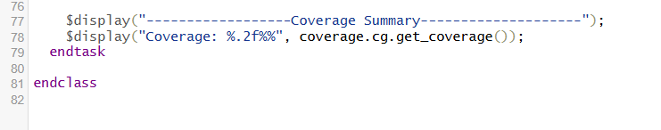
Layered Verification:
Code
Scoreboard

Slide 18
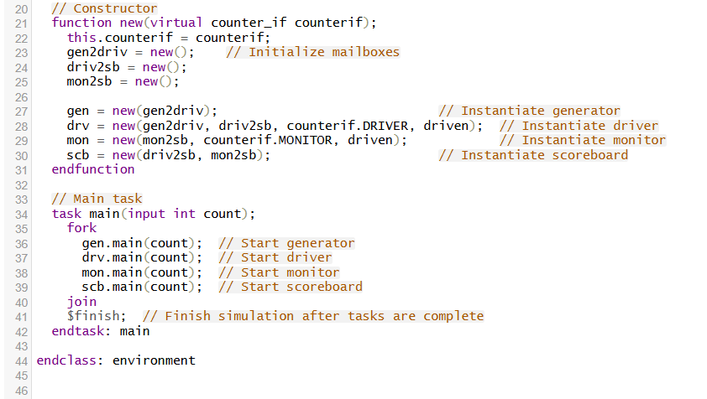
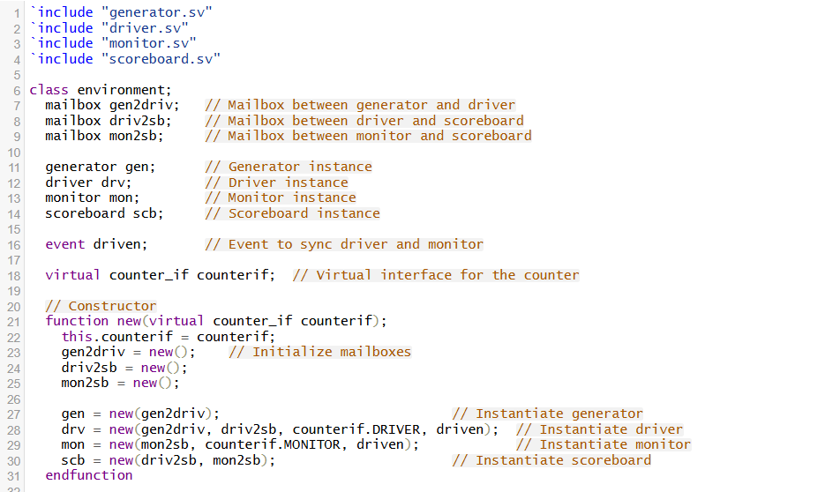
Layered Verification:
Code
Environment

Slide 19
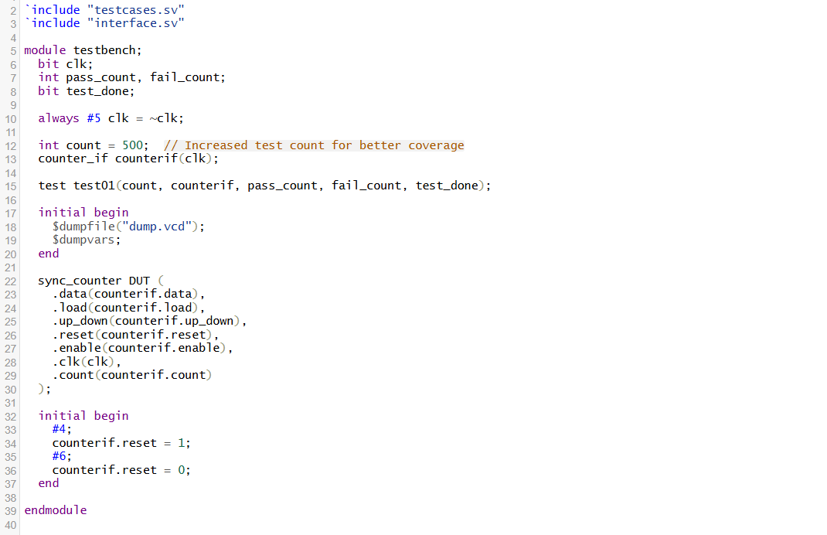
Layered Verification:
Code
Testbench

Slide 20
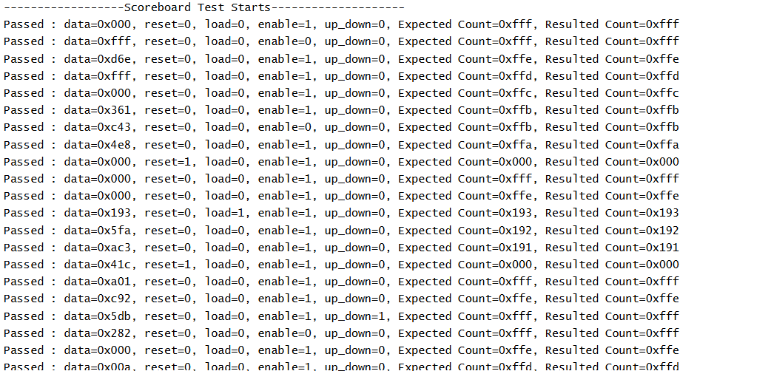
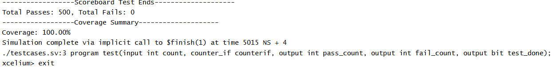
Layered Verification:
Output

Slide 21
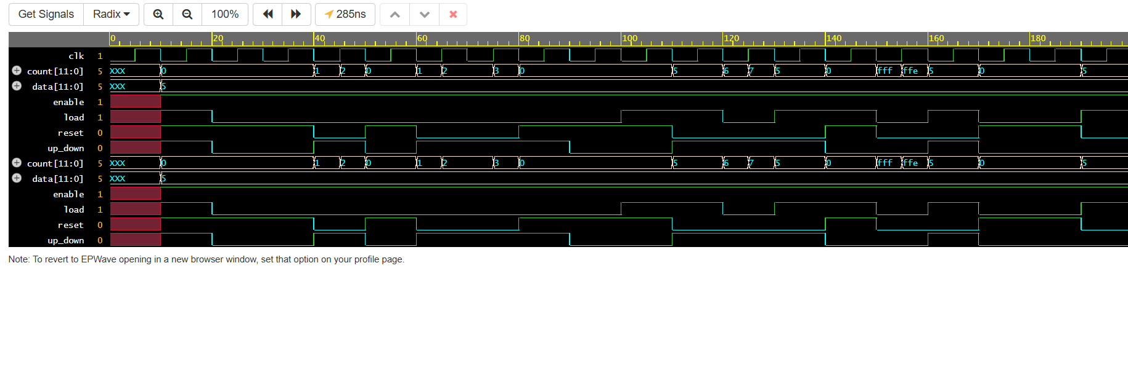
Layered Verification:
Waveform

Slide 22
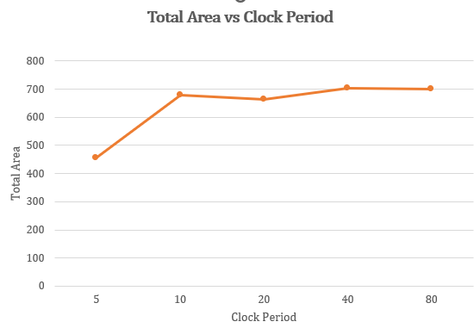
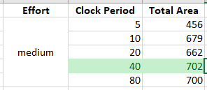
Synthesis Optimization :
Area VS clock period

Slide 23
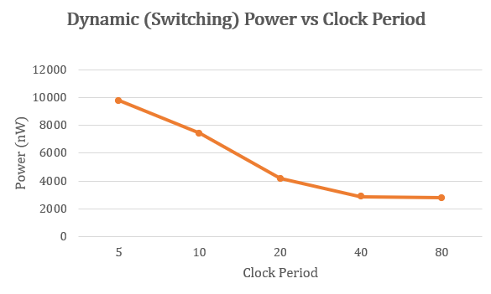
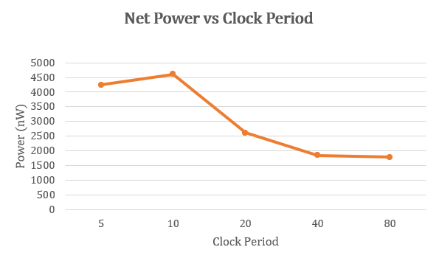
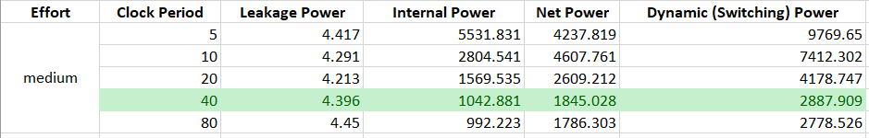
Synthesis Optimization :
Power VS clock period

Slide 24
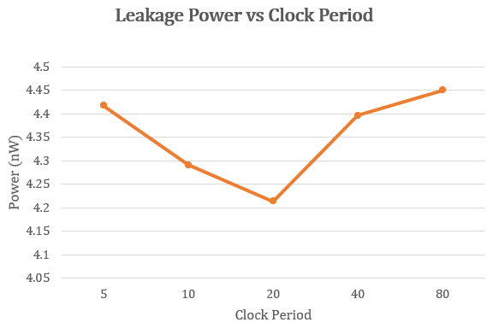
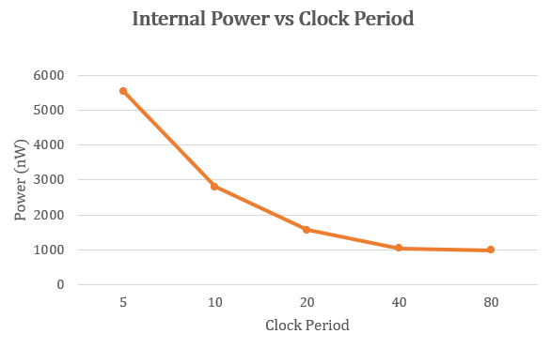
Synthesis Optimization :
Power VS clock period
Optimized clock period is 40 ns

Slide 25
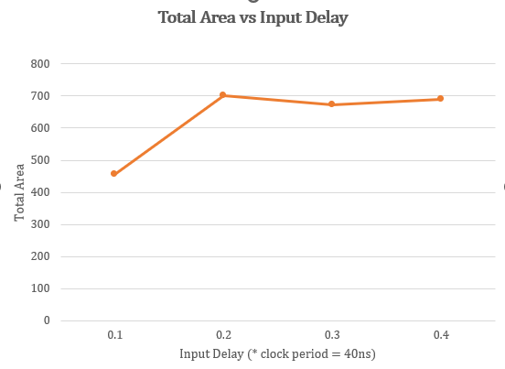
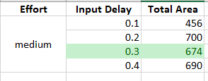
Synthesis Optimization :
Area VS input Delay:

Slide 26
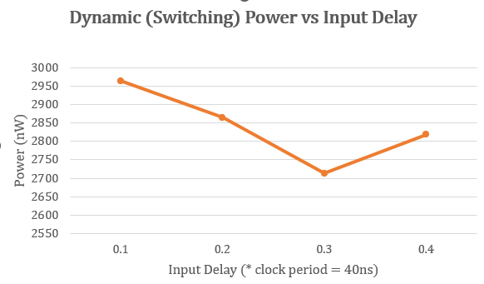
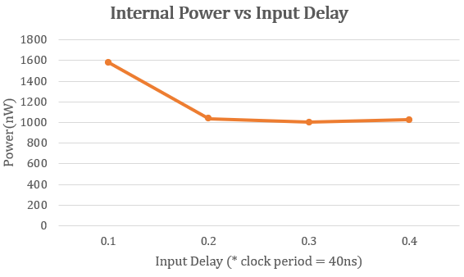
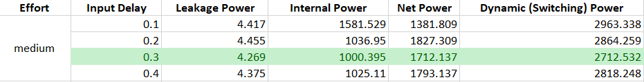
Synthesis Optimization :
power VS input Delay:

Slide 27
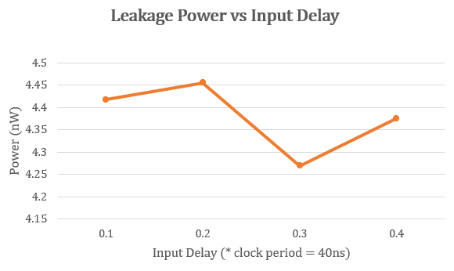
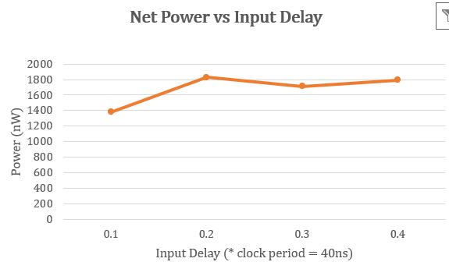
Synthesis Optimization :
power VS input Delay:
Optimized input Delay is 12 ns

Slide 28
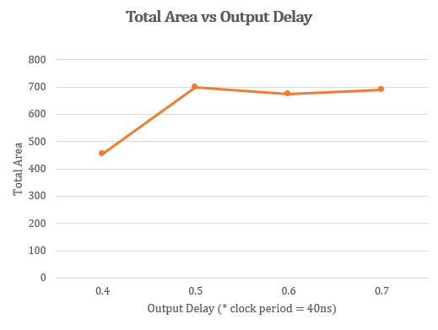
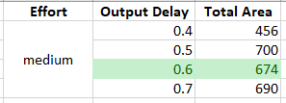
Synthesis Optimization :
Area VS output Delay:

Slide 29

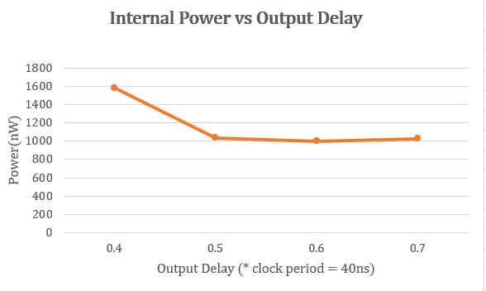
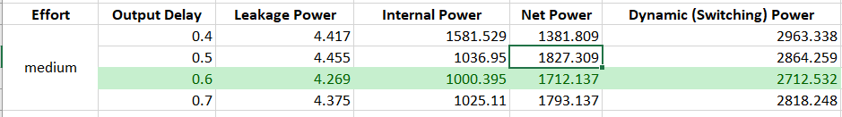
Synthesis Optimization :
power VS output Delay:

Slide 30
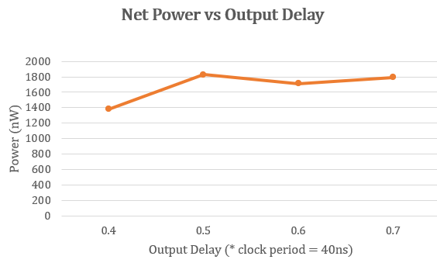
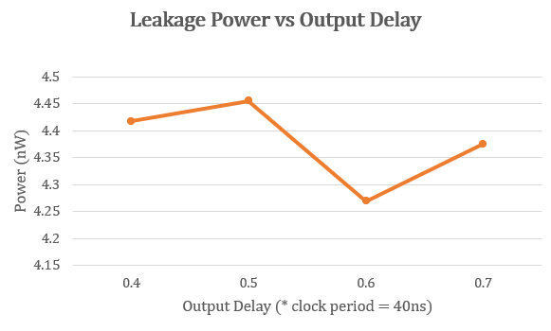
Synthesis Optimization :
power VS output Delay:
Optimized output Delay is 24 ns

Slide 31
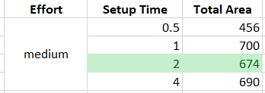
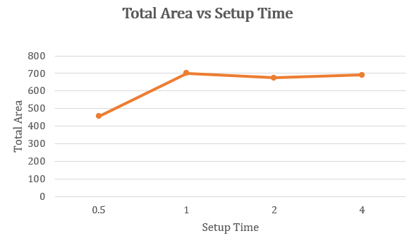
Synthesis Optimization :
Area vs setup time

Slide 32
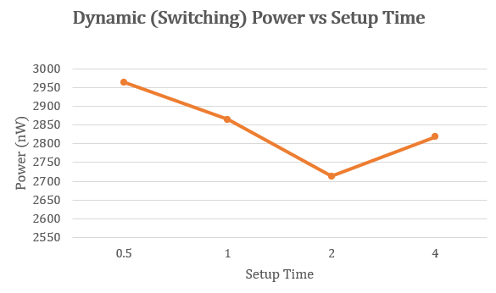
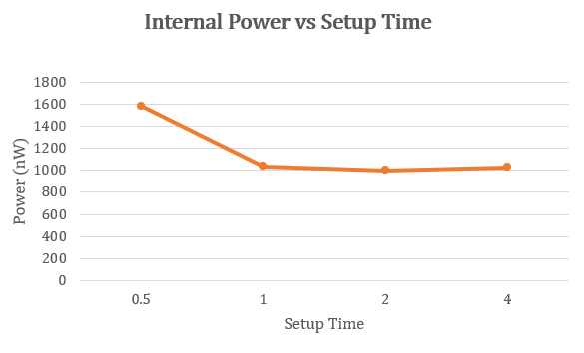
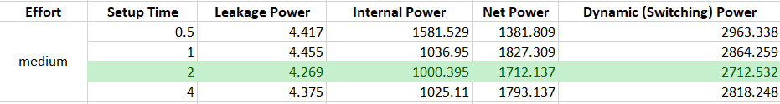
Synthesis Optimization :
Power vs setup time

Slide 33
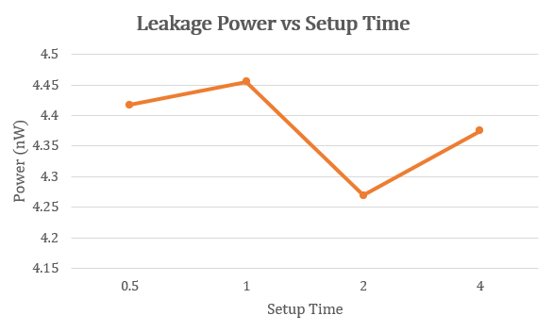

Synthesis Optimization :
Power vs setup time
Optimized setup time is 2 ns

Slide 34


Synthesis Optimization :
Area vs hold time

Slide 35


Synthesis Optimization :
Power vs Hold time

Slide 36


Synthesis Optimization :
Power vs Hold time
Optimized hold time is 0.8 ns

Slide 37

Synthesis Optimization: (Final)

Slide 38


Synthesis Optimization: (Final)

Slide 39


Synthesis Optimization: (Final)

Slide 40

Synthesis Optimization: (Final – high effort)

Slide 41
PnR Optimization:
Design | Floorplan |  |  | Core to io boundaries |  |  |  | Density (%) | Routing overflow (%) |  | Power (uW) |  |  |  | Area (um2)
 | Width | Height | Area | Core to Left | Core to Right | Core to Top | Core to Bottom |  | Horizontal | Vertical | Internal | Switching | Leakage | Total
v01 | 30 | 30 | 900 | 1.2 | 1.2 | 1.71 | 1.71 | 27.585 | 8.08 | 0 | 21.99087 | 7.15901 | 0.01063 | 29.16051 | 195.282
v02 | 25 | 19.95 | 498.75 | 1.2 | 1.2 | 1.71 | 1.71 | 56.146 | 0 | 0 | 21.99099 | 6.30091 | 0.01063 | 28.30253 | 195.282
v03 | 20 | 19.95 | 399 | 1.2 | 1.2 | 1.71 | 1.71 | 72.096 | 0 | 0 | 21.99293 | 6.00114 | 0.01063 | 28.0047 | 195.282
v04 | 18 | 20 | 360 | 0.7 | 0.7 | 0.7 | 0.7 | 67.976 | 0 | 0 | 21.99325 | 6.02615 | 0.01063 | 28.03003 | 195.282
v05 | 17 | 16.91 | 287.47 | 0.6 | 0.6 | 0.76 | 0.76 | 80.309 | 0 | 0 | 21.99262 | 5.93908 | 0.01063 | 27.94234 | 195.282

Slide 42



PnR Optimization:
12 Bits Synchronous Counter
42

Slide 43


PnR Optimization:

Slide 44


PnR Optimization:

Slide 45


PnR Optimization:

Slide 46


PnR Optimization:

Slide 47

PnR Optimization:[v-02]

Slide 48

PnR Optimization:[v-02]

Slide 49


PnR Optimization:[v-02]

Slide 50

PnR Optimization:[v-05]

Slide 51
Thank You

